Slide 1
Fearfully and
Wonderfully Made
Lesson 2: Healthcare &
The Abortion Debate
science and the Bible Series
Dr. Brad Harrub

Slide 2
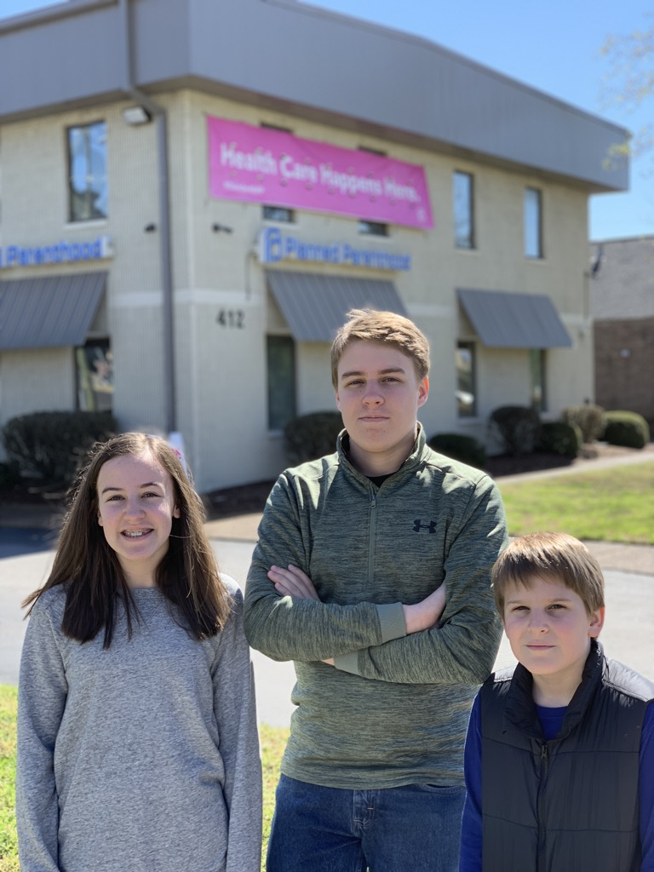
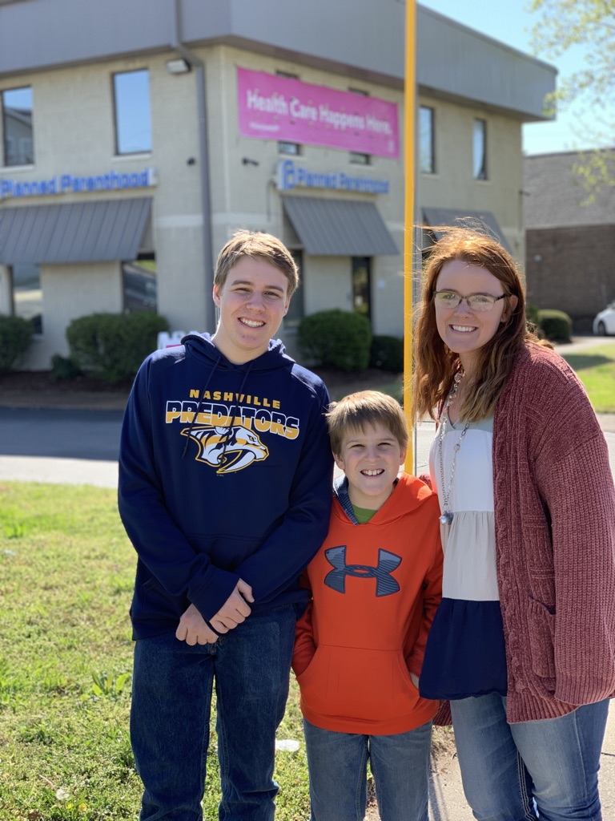

Slide 3
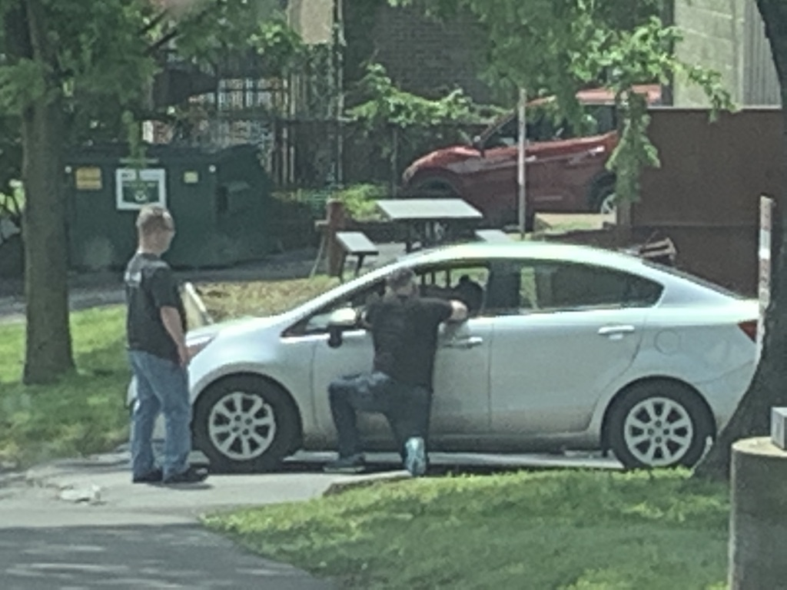
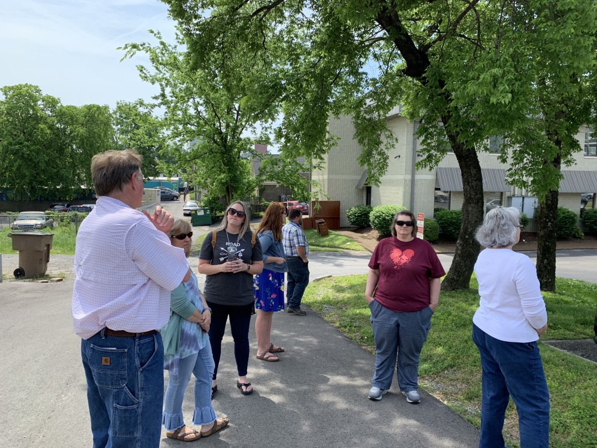

Slide 5
Understand: This de-valuing of human life starts early with the indoctrination of our children.

Slide 6
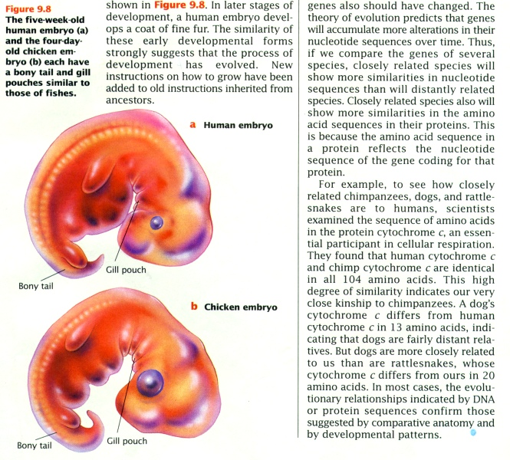
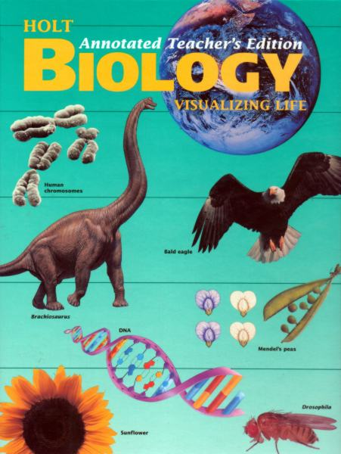
Gill pouch, Holt Biology.
Holt Biology Visualizing Life
p.183

Slide 7
“You are an animal and share a common
heritage with
earthworms.”
Biology: Visualizing Life, Holt,

Slide 8
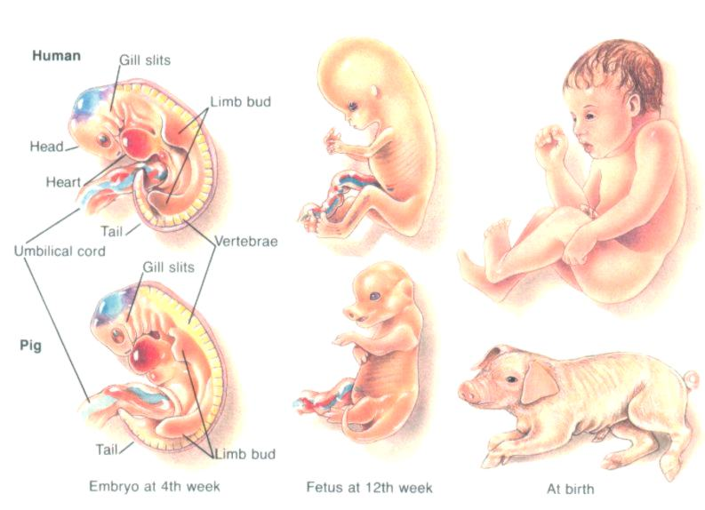
Glenco Biology, Gill slits and tail
Glenco Biology p. 312

Slide 9
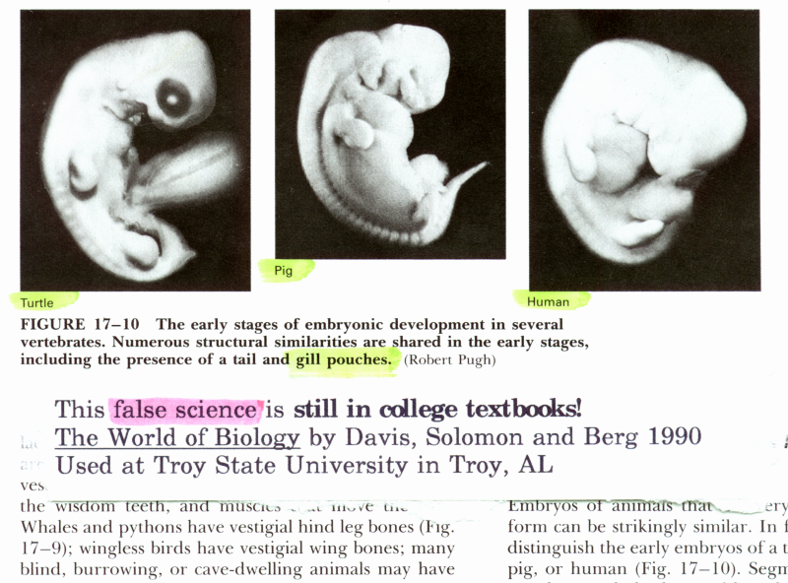
gill slits (college textbook)

Slide 10
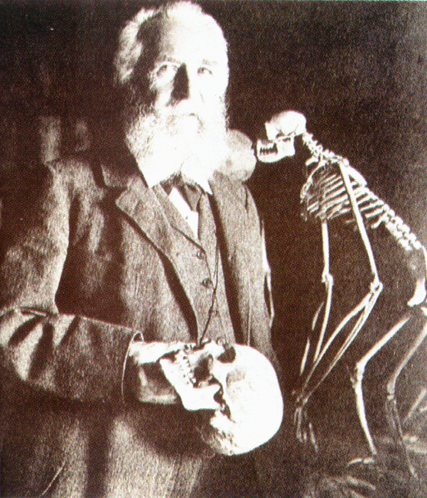
Earnst Haeckel said the turning point
Earnst Haeckel said the turning point in his thinking was when he read Charles Darwin’s Origin of Species in 1860.
Creation March-May 1996 p. 33

Slide 11
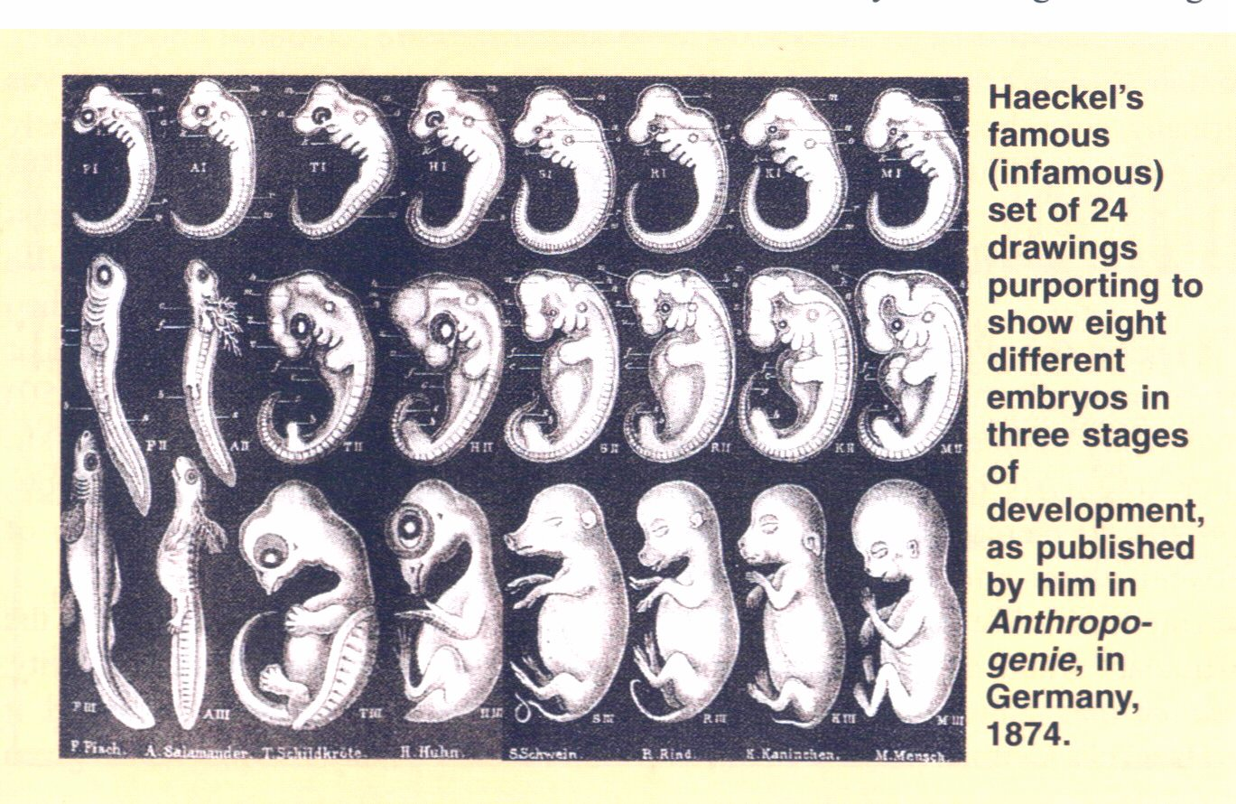
Haeckel’s series of fake drawings, 1874
Haeckel’s fake drawings, 1874
Creation ex nihilo Mar-May 1998 p. 51

Slide 12
16 year old from Michigan
So how do young people view unborn? A young 16 year-old girl found out she was pregnant, so she and her boyfriend devised a “plan.”

Slide 13
And the angel of the Lord said, Behold thou art with fetus? and shalt bear a son.
Genesis 16:11

Slide 14
And the angel of the Lord said, Behold thou art with child, and shalt bear a son.
Genesis 16:11

Slide 15
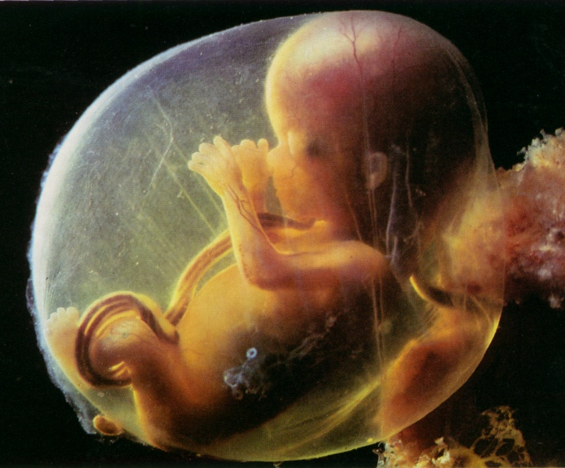
What about abortion?

Slide 16
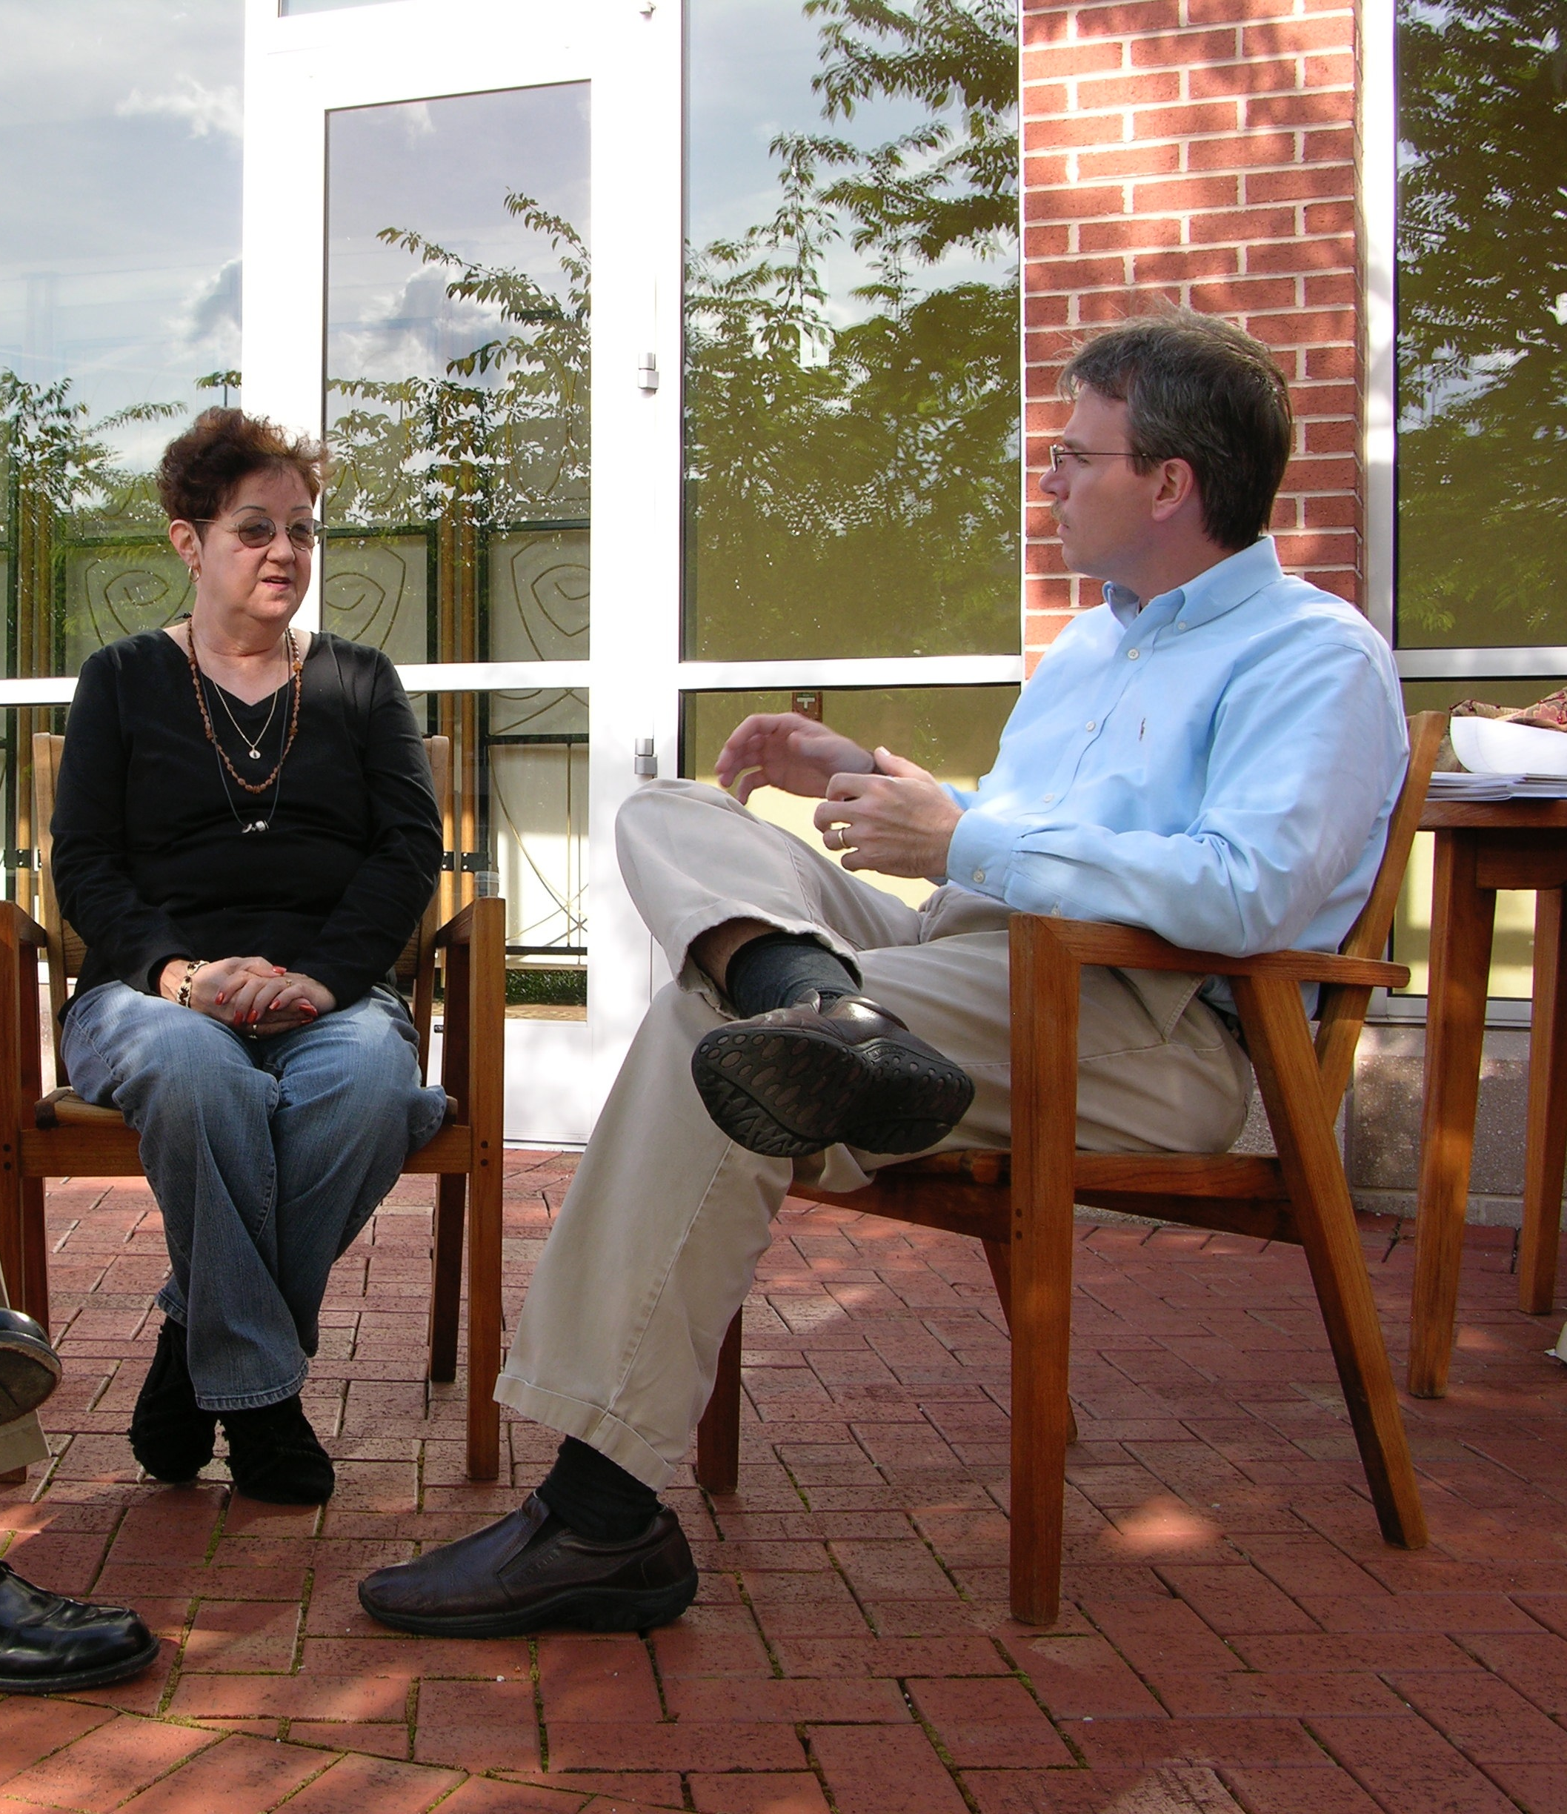
History of Abortion

Slide 17
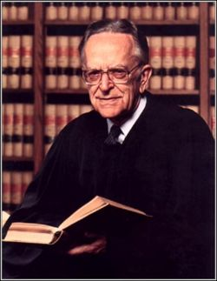
In writing his lengthy opinion for the court in the infamous Roe vs. Wade case, Justice Harry Blackmun stated: “We need not resolve the question of when life begins.”

Slide 18
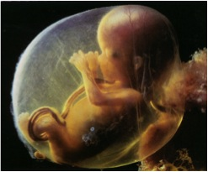
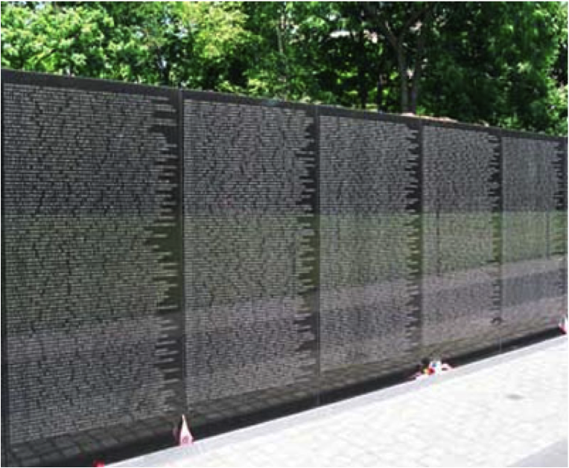
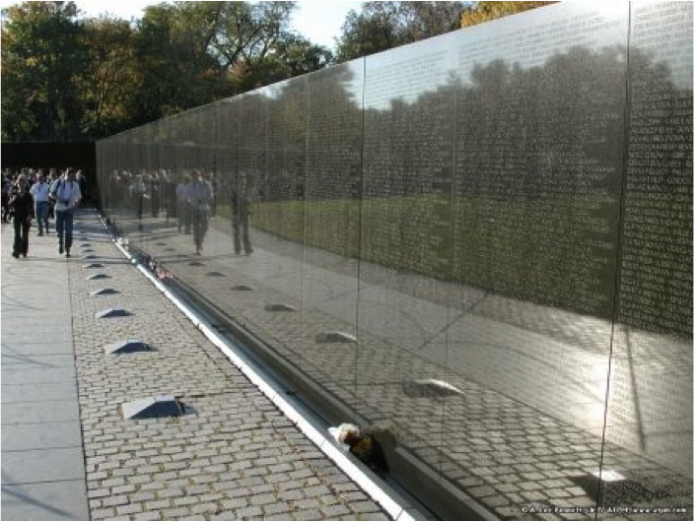
And yet, we continue to abort 4500 unborn children everyday.

Slide 19
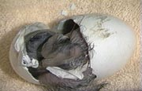
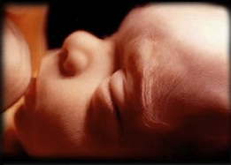
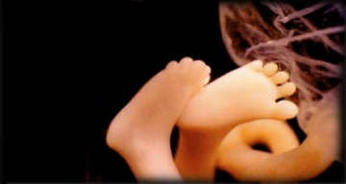
11 Week Girl
5 Month Girl

Slide 20
In 1981, Physicians and Geneticists testified before the Senate Judiciary Committee. All were in agreement. Dr. McCarthy de Mere “The exact moment of the beginning of personhood and of the human body is at the moment of conception.” Dr. Jerome Lejeune (Father of Modern Genetics) “To accept the fact that after fertilization has taken place a new human has come into being is no longer a matter of taste or opinion…it is plain experimental evidence.”

Slide 21
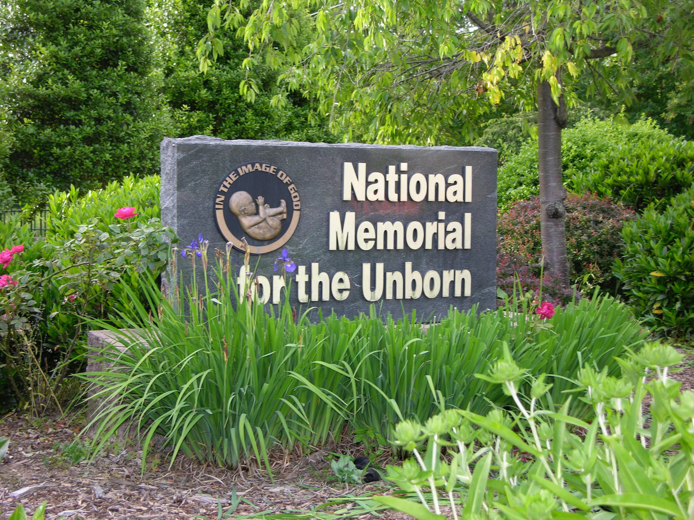

Slide 22
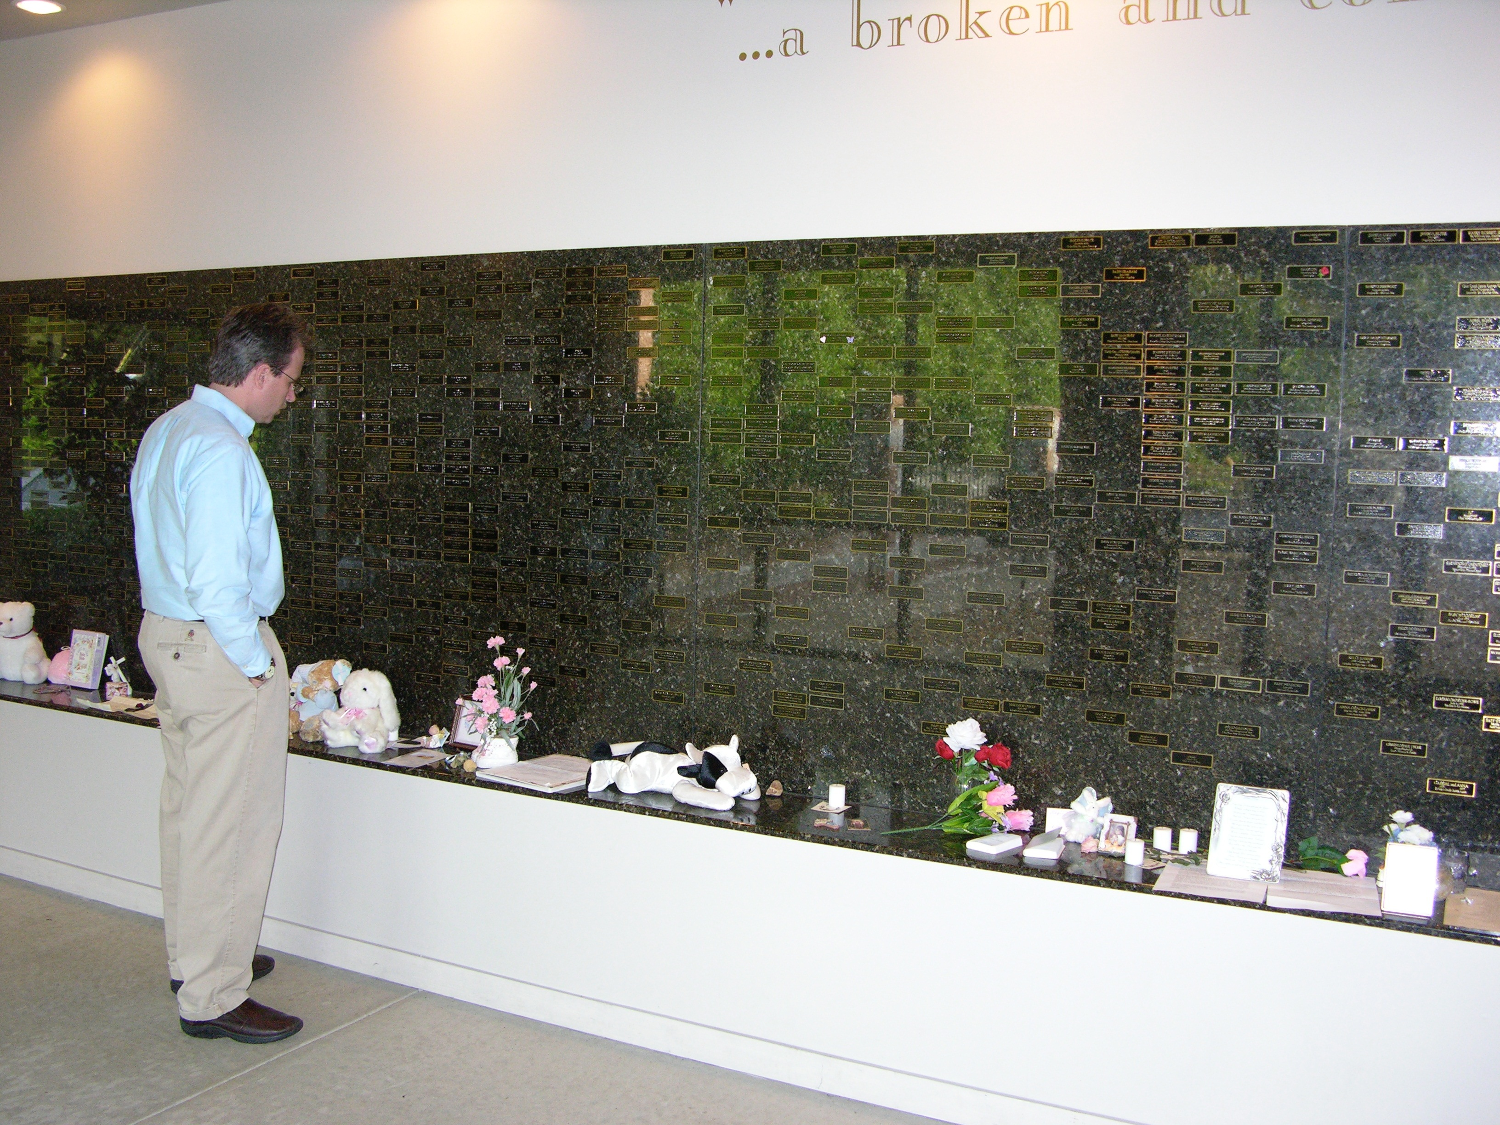

Slide 23
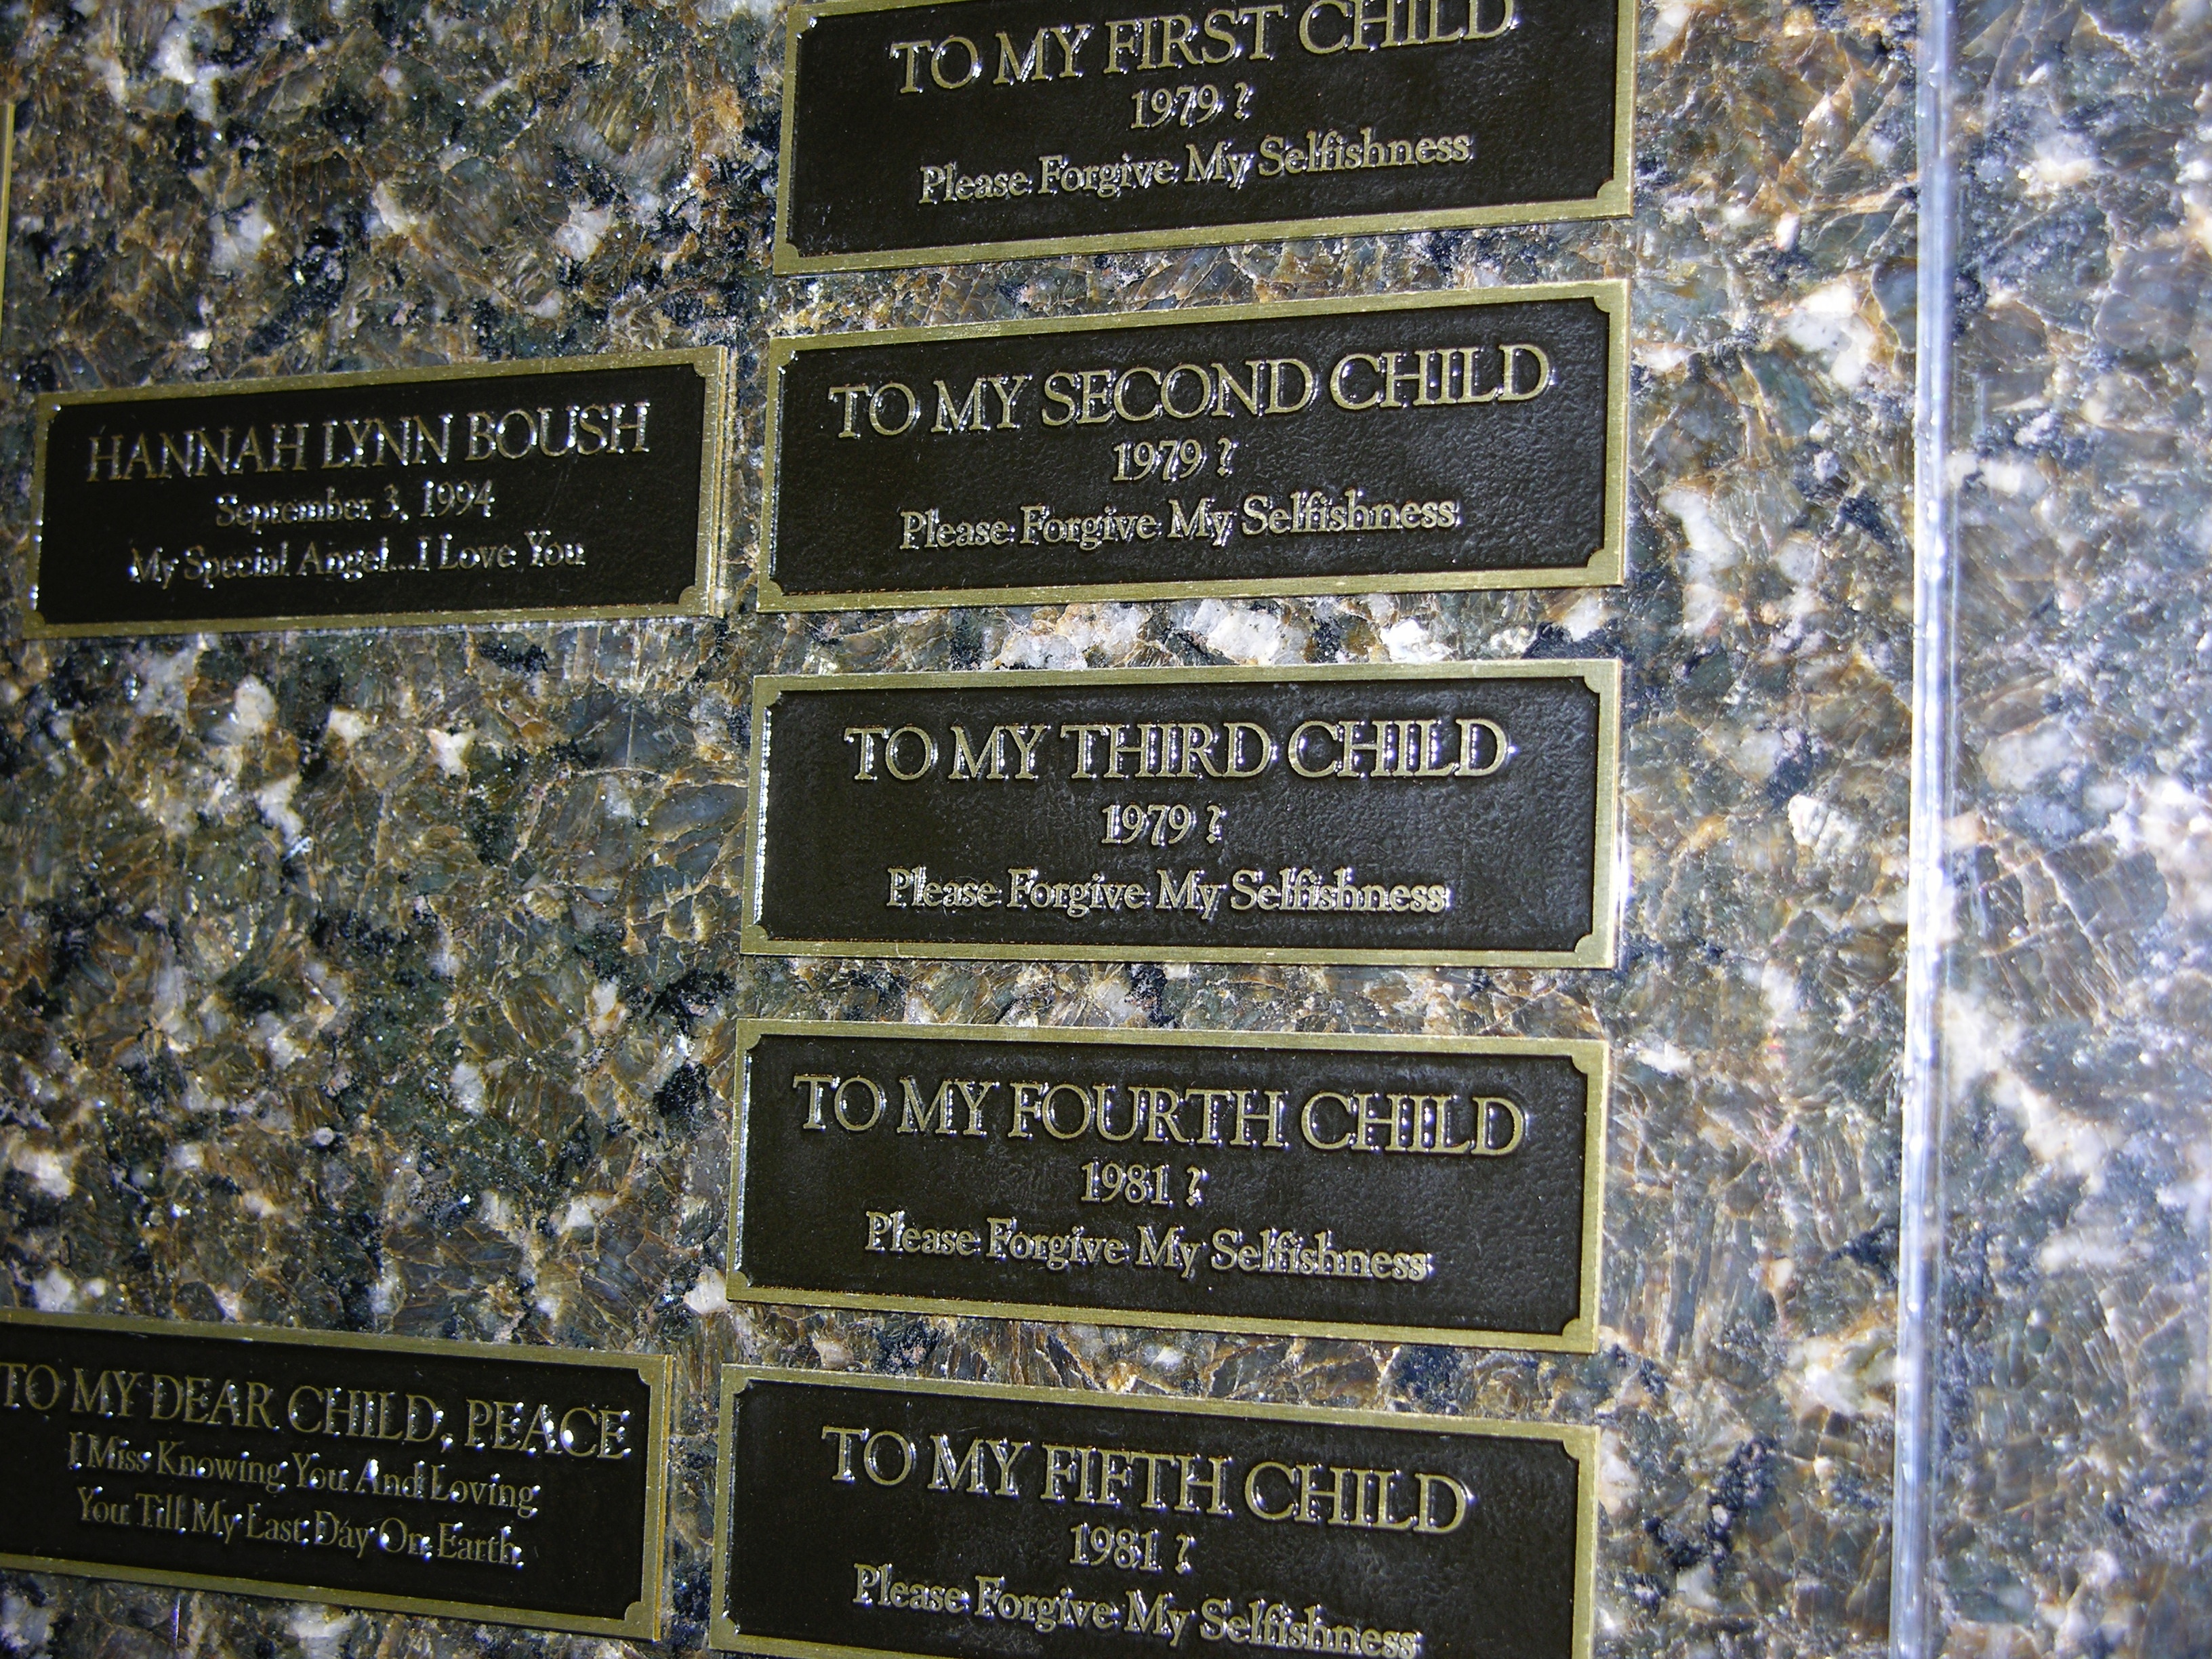

Slide 24
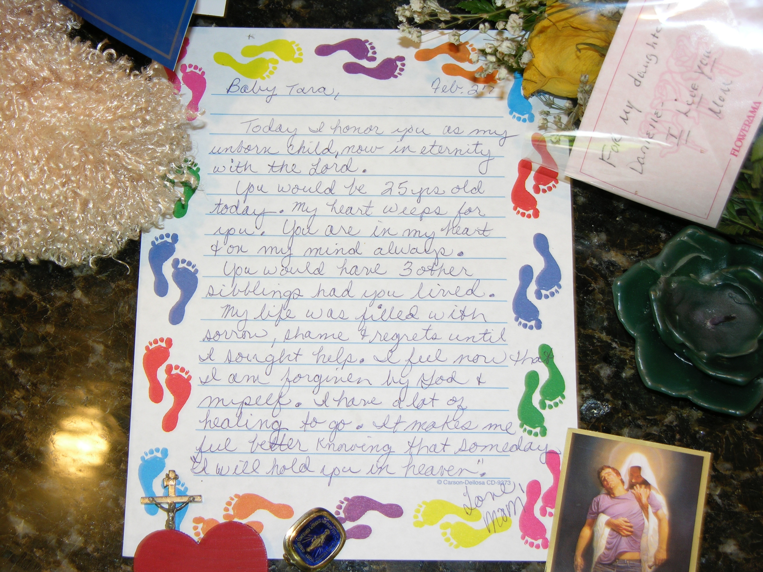

Slide 25
American War Casualties (each cross = 50,000 casualties)
CIVIL WAR |  | 498,332
WORLD WAR I |  | 116,708
WORLD WAR II |  | 407,316
KOREAN WAR |  | 54,246
VIETNAM WAR |  | 58,655
PERSIAN GULF WAR |  | 372
WAR ON UNBORN |  | 44,670,812

Slide 26
Five steps to a partial birth abortion:
1) Guided by ultrasound, the abortionist grabs the baby's legs with forceps.
2) The baby's leg is pulled out into the birth canal.
3) The abortionist delivers the baby's entire body, except for the head
4) The abortionist jams scissors into the baby's skull. The scissors are then opened to enlarge the skull.
5) The scissors are removed and a suction catheter is inserted. The child's brains are sucked out, causing the skull to collapse. The dead baby is then removed.

Slide 27
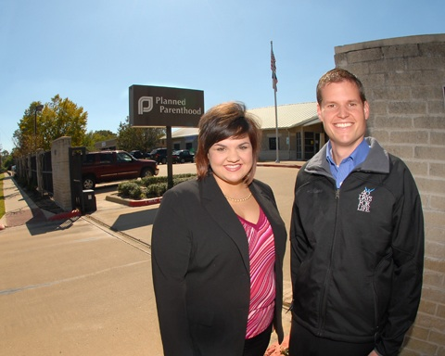
Abby Johnson

Slide 28
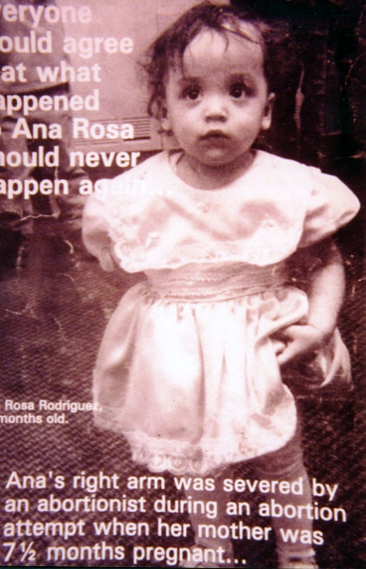
Cursed be he that taketh reward to slay an innocent person. Deut. 27:25
Cursed be he that taketh reward to slay an innocent person. And all the people shall say, Amen.
Deut. 27:25

Slide 29
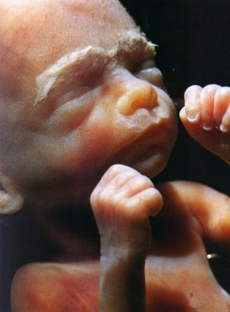
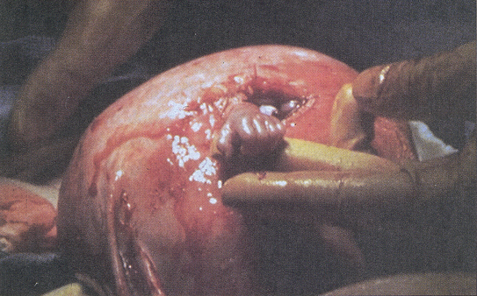
What is life?

Slide 30
When does life begin
according to the Bible?
Isaiah 49: 1,5
Jeremiah 1:5
Psalm 139:13-14
Job 3:13-16
Job 39:13-16
Luke 1:41-44
James 2:26

Slide 31
“The Lord has called me from the womb; from the bowels off my mother hath he made mention of my name” (Isaiah 49:1)
“And now the Lord says, Who formed me from the womb to be His servant.” (v. 5)

Slide 32
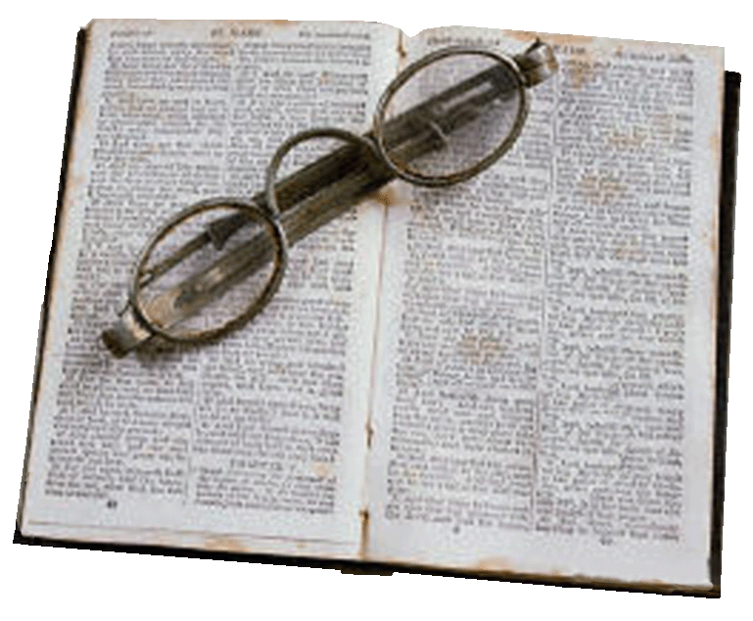
“Before I formed you in the womb I knew you; Before you were born I sanctified you”
(Jeremiah 1:5)

Slide 33
For You formed my inward parts; You covered me in my mother’s womb. I will praise You for I am fearfully and wonderfully made, marvelous are Your works. And that my soul knows very well. My frame was not hidden from You, and skillfully wrought in the lowest parts of the Earth. Your eyes saw my substance, being yet unformed” Psalm 139:13-16).

Slide 34
Job 3:13-16
- Princes
- Counselors
- Kings
And a child who experienced a hidden untimely birth…a miscarriage.

Slide 35
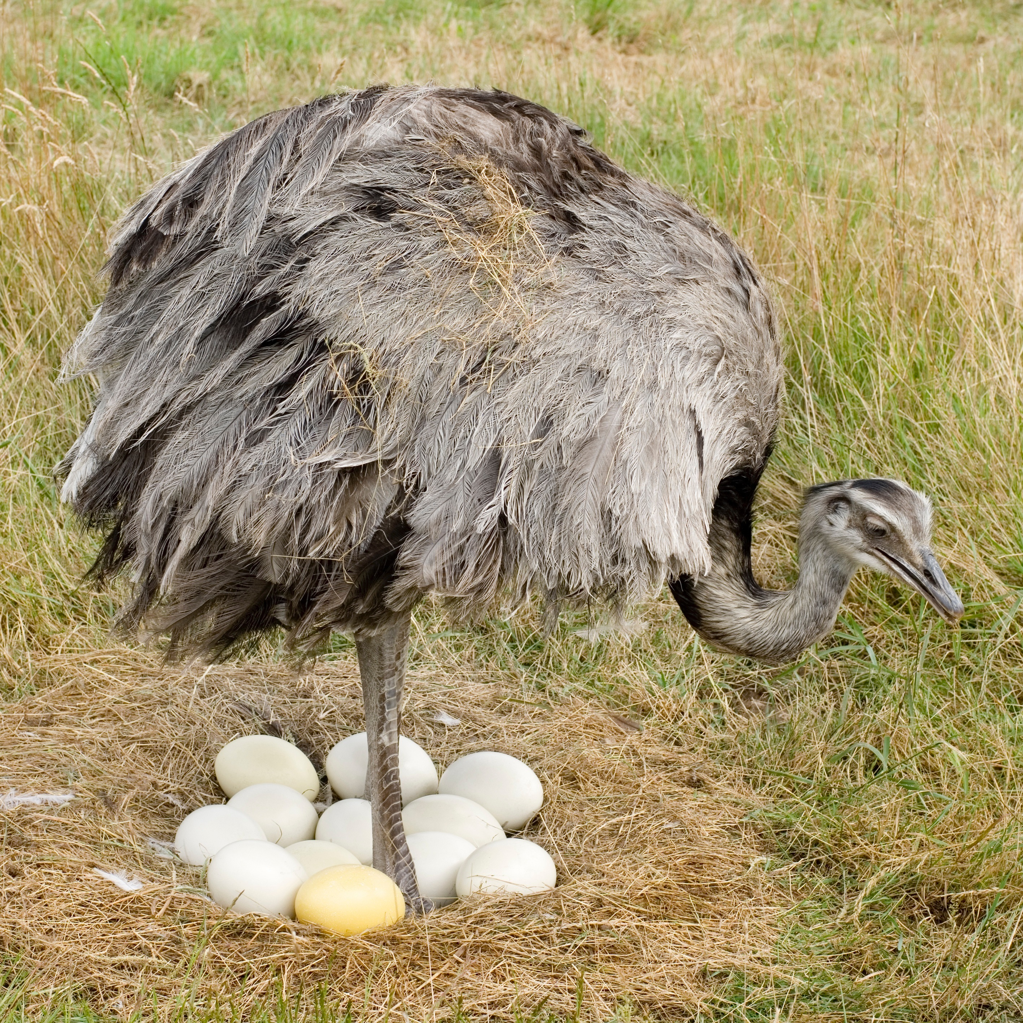
Job 39:14-17
“For she leaves her eggs on the ground, and warms them in the dust. She forgets that a foot may crush them, or that a wild beast may break them. She treats her young harshly, as though they were not hers; Her labor is in vain, without concern. Because God hath deprived her of wisdom, neither hath he imparted to her understanding.”
(v. 14-17).

Slide 36
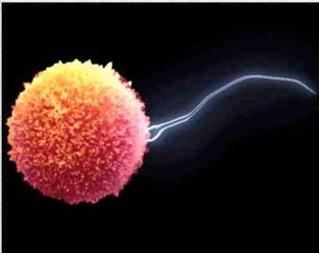
It is not by accident that the moment of conception is mention over 40 times in God’s Word.
God views life to begin at conception, not birth.

Slide 37
“Now Adam knew Eve his wife, and she conceived and bore Cain, and said, “I have acquired a man from the Lord” Genesis 4:1.
“And Cain knew his wife, and she conceived and bore Enoch” Genesis 4:17.

Slide 38
“And behold, you will conceive in your womb and bring forth a Son, and shall call His name Jesus” (Luke 1:31).
“Now indeed, Elizabeth your relative has also conceived a son in her old age;” Luke 1:36).
“And it happened, when Elizabeth heard the greeting of Mary, that the babe leaped in her womb…” (Luke 1:41).

Slide 39
And the angel of the Lord said, Behold thou art with fetus? and shalt bear a son.
Genesis 16:11

Slide 40
And the angel of the Lord said, Behold thou art with child, and shalt bear a son.
Genesis 16:11

Slide 41
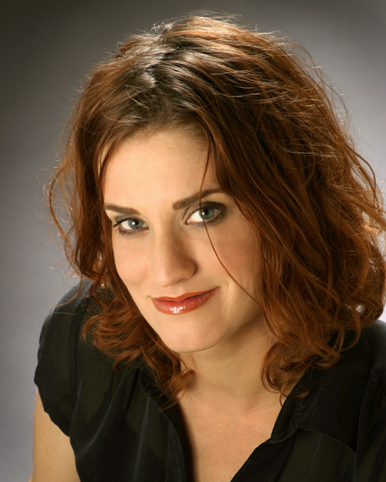
Gianna Jessen

Slide 42
Friends, we are no longer satisfied with just killing the unborn or elderly.

Slide 43
In many hospitals that don’t have a religious
affiliation there is a little room…

Slide 44
We must remember…
Genesis 1:26-27 informs us that we were made in the image and likeness of God—the Giver of life as He is described in Acts 17:28.
We must keep in the forefronts of our minds that if we continue to allow human life to be devalued, we are in essence, reducing the value of God’s gift of His only begotten Son.

Slide 45
The value of a life…

